Slide 1
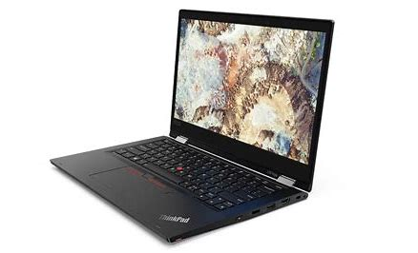
PlusPoints
Photomath
Dateien
ZHAW LSFM
ZHAW Moodle
Outlook
DeepL
SimpleClub
Quizlet

